Slide 1

American Sign Language Recognition System
CBIR review 2

Slide 2
INTRODUCTION
The basic goal of this project is to transliterate 24 static sign language alphabets and numbers into humanoid or machine-readable English manuscripts in American Sign Language. The preprocessing operation for the signed input gesture is performed within the first phase. In the next section , the various areas of the preprocessed gesture image are calculated. In the last section, the transliteration of the signed gesture to text is complete, based on the property calculated in the previous phase..

Slide 3
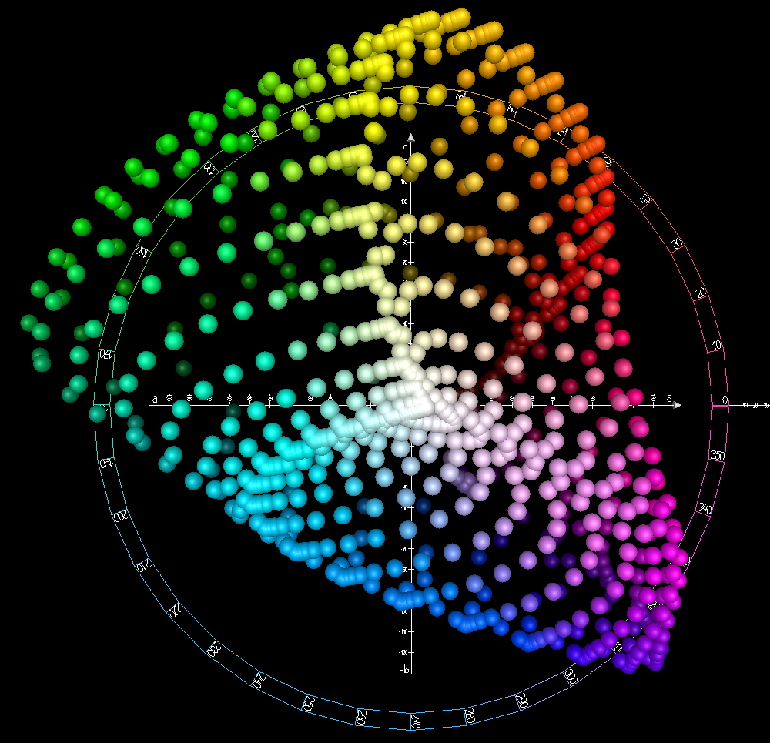
PHASE 1
Read
Read an input RGB
Convert
Convert HSV image to YCbCr
Detect
Detect the Skin region using cb and cr range
Convert
Convert YCbCr to gray format
Convert
Convert to binary
Find
Find the Gray threshold value using Otsu’s method
This Photo by Unknown author is licensed under CC BY-SA.

Slide 4
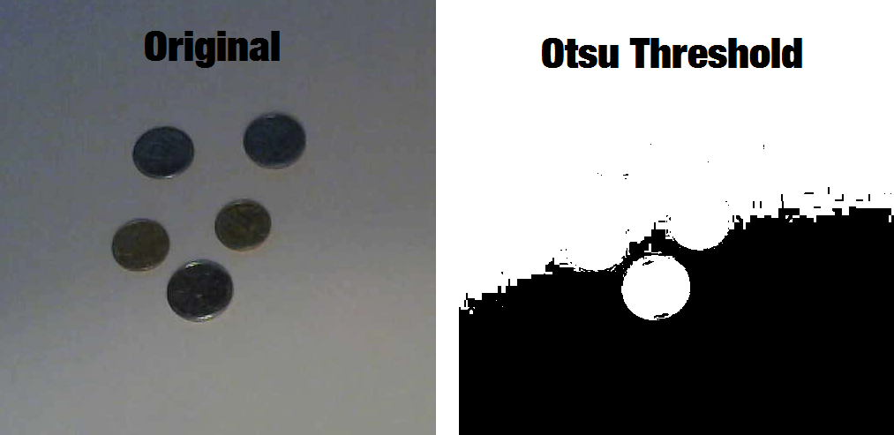
otsu grey thresholding
the algorithm returns a single intensity threshold that separate pixels into two classes, foreground and background. This threshold is determined by minimizing intra-class intensity variance, or equivalently, by maximizing inter-class variance. Otsu's method is a one-dimensional discrete analog of Fisher's Discriminant Analysis, is related to Jenks optimization method, and is equivalent to a globally optimal k-means performed on the intensity histogram
This Photo by Unknown author is licensed under CC BY-NC.

Slide 5

Why HSV model?
HSV (Hue, Saturation, and Value) color model is a perceptual color model, used in separating an image luminance (V) from color facts. Opting an HSV color initiates with opting one of the existing hues, which is how most people narrate to color than does the RGB color space, and then regulating the shade and intensity value. HSV color space is used in the circumstances where color depiction acting a vital role

Slide 6
Advantages of YCbCr
In order to optimize the functioning of skin color clustering, the present work uses YCbCr color space to construct a skin color model, as it is also known that, as the chrominance factors are almost self-governing of luminance factor in the space. There are non-linear relationships between chrominance (Cb, Cr) and luminance (Y) of skin pixel color in the high and low luminance region. Luminance may vary depending on an individual’s face because of ambient lighting. Hence, the YCbCr Color model is very beneficial to optimize the performance of skin color clustering
This Photo by Unknown author is licensed under CC BY-SA.

Slide 7
Gray threshold value using Otsu’s method
the algorithm returns a single intensity threshold that separate pixels into two classes, foreground and background. This threshold is determined by minimizing intra-class intensity variance, or equivalently, by maximizing inter-class variance. Otsu's method is a one-dimensional discrete analog of Fisher's Discriminant Analysis, is related to Jenks optimization method, and is equivalent to a globally optimal k-means performed on the intensity histogram. The extension to multi-level thresholding was described in the original paper, and computationally efficient implementations have since been proposed
This Photo by Unknown author is licensed under CC BY-NC.

Slide 8
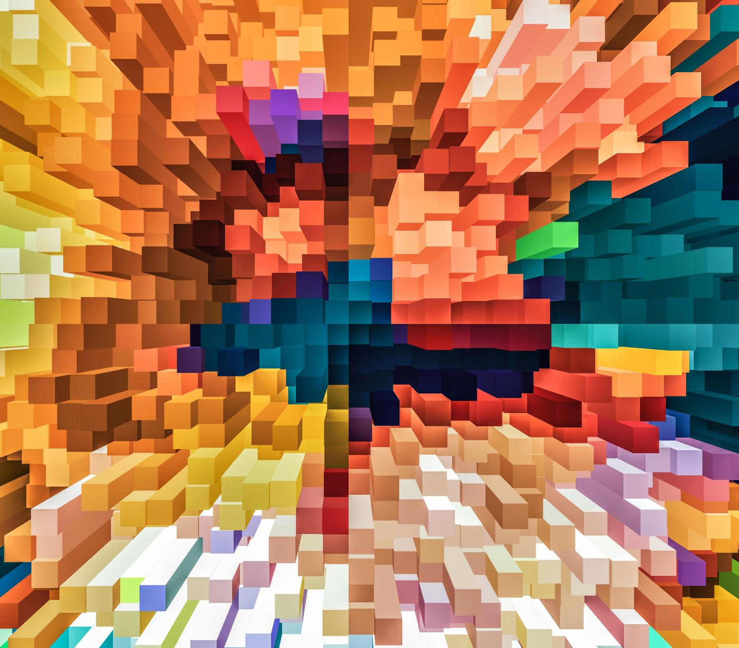
PHASE -2
Get
Get the preprocessed image
Obtain the Centroid of the preprocessed image
Find
Find the Area and Perimeter
Compute
Compute Roundness and Boundary
Calculate
Calculate peak offset
Find
Find number of peaks
Recognize the Gestures using the value of the Roundness and number of Peaks obtained
Recognise
Obtain

Slide 9

PHASE -3
The transliteration of the signed gesture to text is complete .

